Slide 1
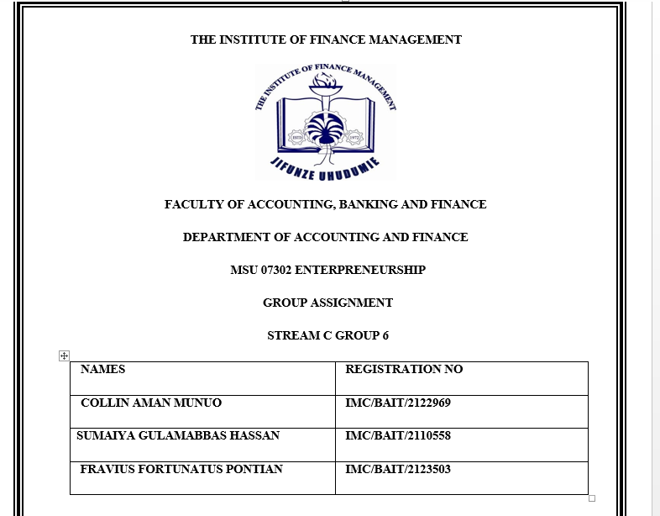

ENTREPRENEURSHIP ASSIGNMENT BAIT 3C GROUP6

Slide 2
CONSRUCT A BUSINESS MODEL FOR A NEW VENTURE
WHAT IS A BUSINESS MODEL
A business model is a plan or framework for how a business will create , deliver and capture value. It outlines the key components of a company’s operation that includes the target customer, the product or service it will offer, its revenue sources, cost structure, and the distribution channels.
A business model serves as a foundation for a company’s strategy and helps to illustrate how the business will be profitable and sustainable over time

Slide 3
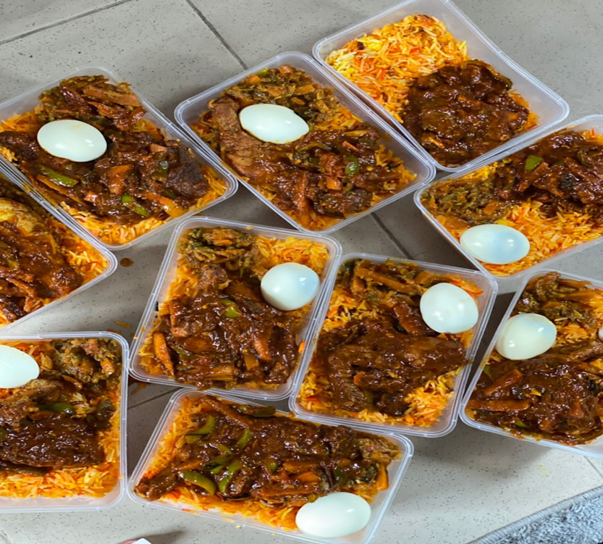
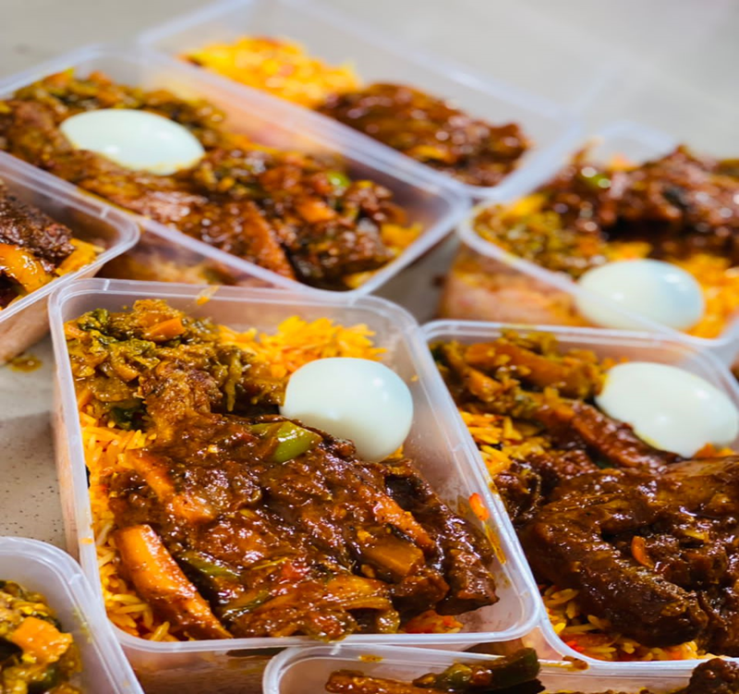
A BUSINESS MODEL FOR A PERSONALIZE MEAL AND DELIVERY SERVICE

Slide 4
Key components of a business model
CUSTOMER SEGMENTS
Are those specific group of customers with similar needs and characteristic that a business target
Hence our customer segment were individuals and families who are looking for convenient and personalized meal solutions
VALUE PROPOSITION
Are those unique benefits or solution that a company offer to its customers to address their needs and problem
The business offers personalized meal plans tailored to each customer's dietary needs, preferences, and health goals, along with the convenience of having those meals delivered to their doorstep.

Slide 5
CHANNELS
The various methods and platforms through which a company reaches and interacts with its customers to deliver its value proposition.
The service utilizes online platforms, social media, and partnerships with nutritionists and health coaches to reach potential customers.
CUSTOMER RELATIONSHIP
The ways in which a company builds and maintains relationships with its customers to enhance satisfaction and loyalty. The business focuses on building long-term relationships with customers by providing excellent customer service, offering ongoing support and engagement through its online platform and social media channels.
REVENUE STREAMS
The sources of income and how a company generates revenue from its value proposition and customer segments. The business generates revenue through subscription fees for personalized meal plans, as well as meal delivery fees.

Slide 6
KEY RESOURCES
The essential assets, such as people, technology, or infrastructure, that a company needs to deliver its value proposition and operate its business.
The key resources include a team of nutritionists and chefs to create personalized meal plans, a delivery network, and an online platform for customer interaction.
KEY ACTIVITIES
The critical actions and processes that a company must perform to create and deliver its value proposition to its customers.
The key activities include creating personalized meal plans, developing and updating the online platform, meal preparation, and delivery.

Slide 7
KEY PARTNERSHIPS
The strategic alliances and collaborations that a company forms with other organizations to enhance its capabilities and reach its goals.
The business may partner with nutritionists, health coaches, and local food suppliers to enhance its offerings and reach a broader customer base.
COST STRUCTURE
The various costs and expenses that a company incurs to operate its business and deliver its value proposition to its customer segments.
The primary costs include ingredient sourcing, meal preparation, delivery expenses, technology and platform maintenance, as well as costs associated with staffing and partnerships.

Slide 8


Thank you very much!!- Cheers blessed

